Slide 1
DIGITAL PORTFOLIO
NAME : karthika . g
REGISTER NO : bruau2422k2447
NM ID : E87258EABCBA7F2B9CD4A6555D308ECF
DEPARTMENT : II – B.Sc ( Computer science )
COLLEGE : lrg women’s arts and science college

Slide 2
PROJECT TITLE
Interactive digital portfolio

Slide 3
AGENDA
PROBLEM STATEMENT
PROJECT OVERVIEW
END USERS
TOOLS AND TECHNOLOGIES
PORTFOLIO DESIGN AND LAYOUT
FEATURE AND FUNCTIONALITY
RESULT AND SCREENSHOTS
CONCLUSION
GITHUB LINK

Slide 4
PROBLEM STATEMENT
Many students struggle to showcase their skills and projects effectively.
Traditional resumes lack visual appeal and interactivity
Need for a digital portfolio that highlights project, skills, and achievements clearly

Slide 5
PROJECT OVERVIEW
Developed a personal portfolio website for showcasing academic and technical skills.
Includes sections for About, Skills, Projects, and Contact.
Responsive design for both desktop and mobile users.

Slide 6
END USERS
Students & job seekers to present their work.
Recruiters to evaluate candidate skills quickly.
Client/Companies looking for project sample.

Slide 7
TOOLS AND TECHNOLOGIES
HTML, CSS, JavaScript – Structure, design, interactivity
Bootstrap/CSS Flexbox/Grid – Responsiveness
GitHub – Version control & hosting

Slide 8
PORTFOLIO DESIGN & LAYOUT
Hero banner with intro + resume button
Profile section with photo & detail
Skills with progress bars
Projects displayed in card layout
Certificates gallery
Contact form + footer

Slide 9
FEATURES & FUNCTIONALITY
Responsive website (mobile + desktop)
Project showcase with descriptions
Interactive skill progress bars
Certificate gallery with hover effects
Contact form with email & phone info

Slide 10
RESULT & SCREENSHOTS
Personal portfolio website build
Clear display of Skills, achievements, and projects
Screenshots : Below the screenshots are my portfolio website

Slide 11
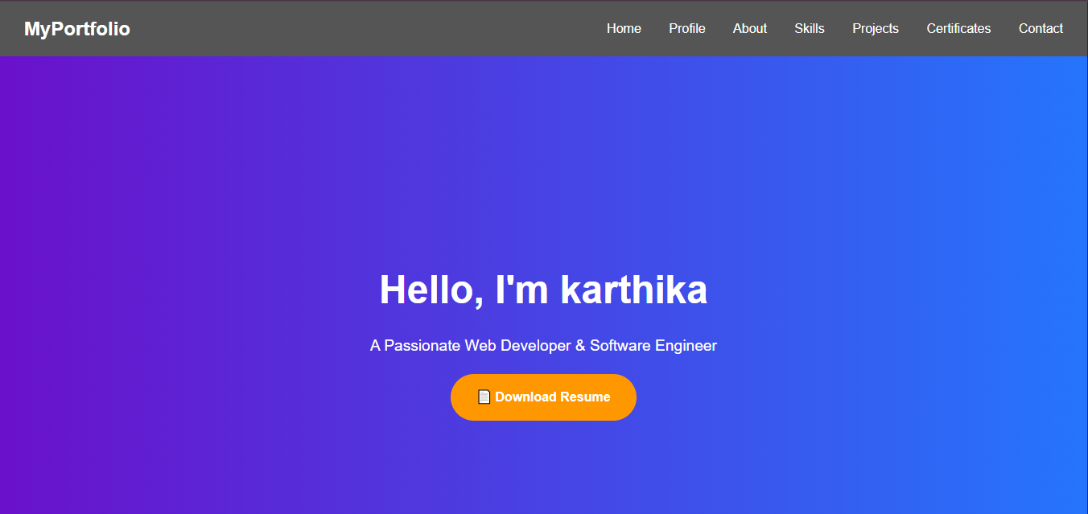

Slide 12
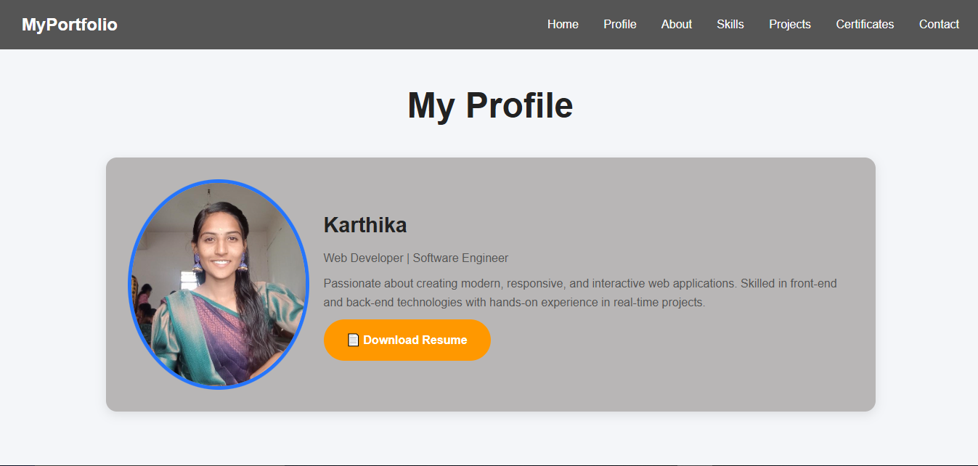

Slide 13
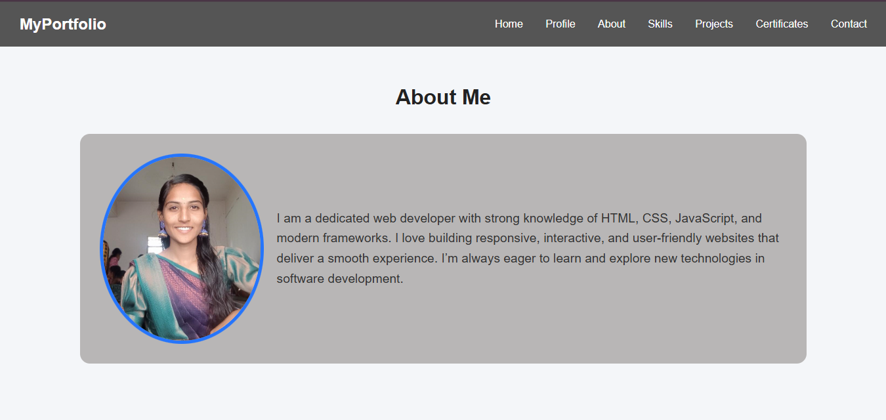

Slide 14
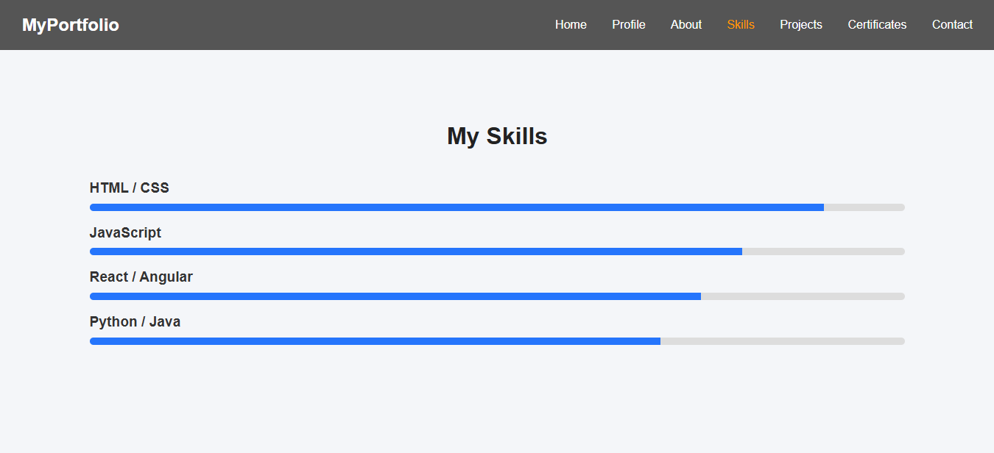

Slide 15
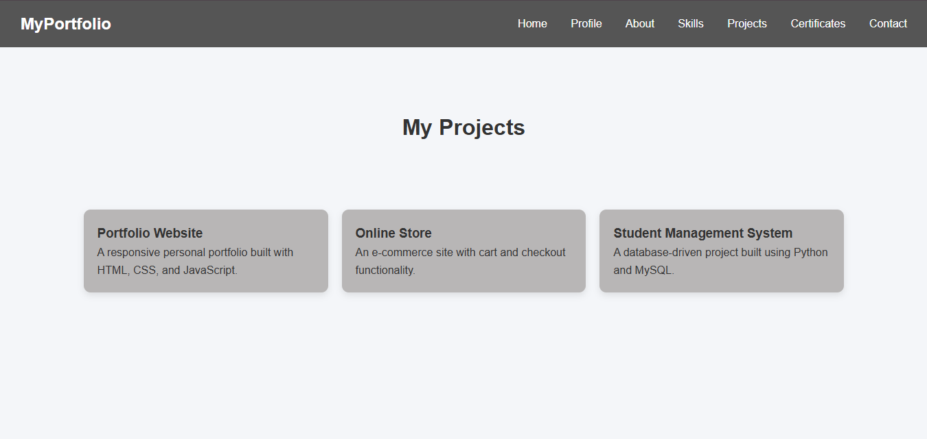

Slide 16
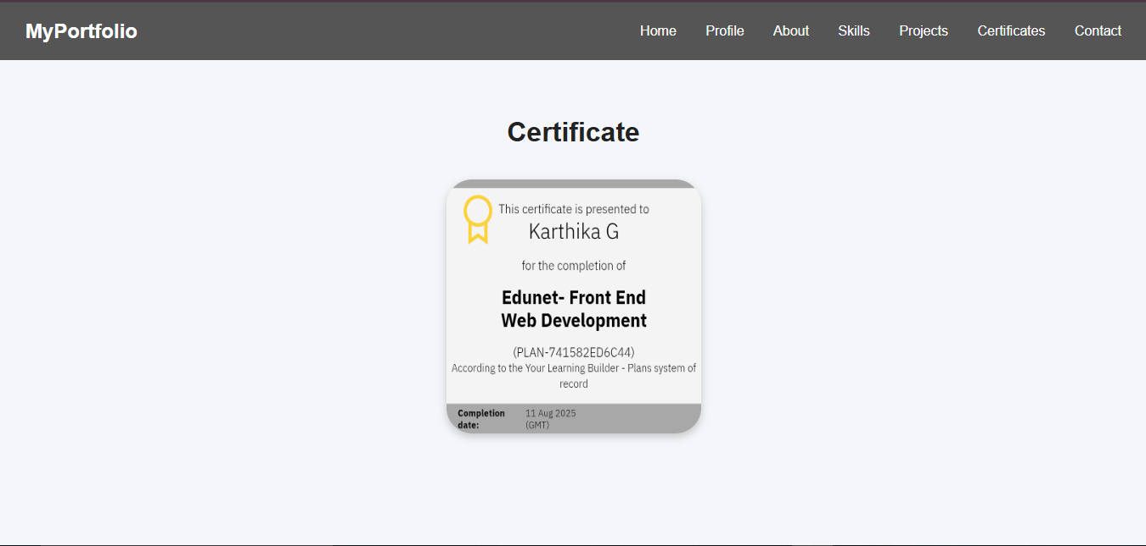

Slide 17
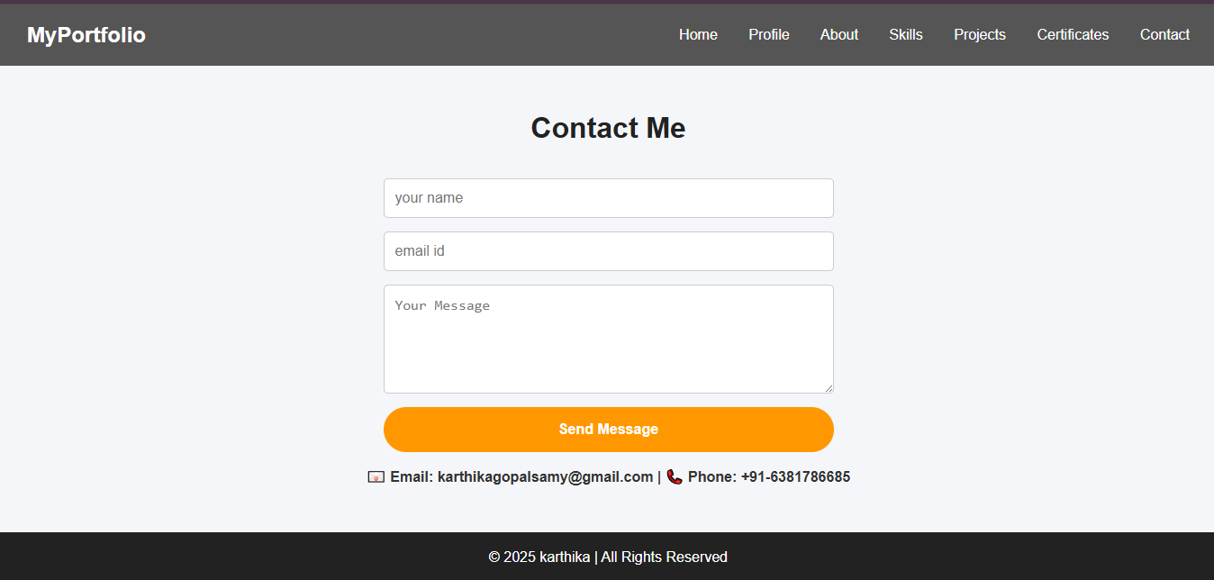

Slide 18
CONCLUSION
Portfolio acts as a digital resume
Display achievements and skills in one place
Enhances personal branding and job opportunities

Slide 19
GITHUB LINK
https://github.com/karthikagopalsamy28-maker/Karthika

